Slide 1
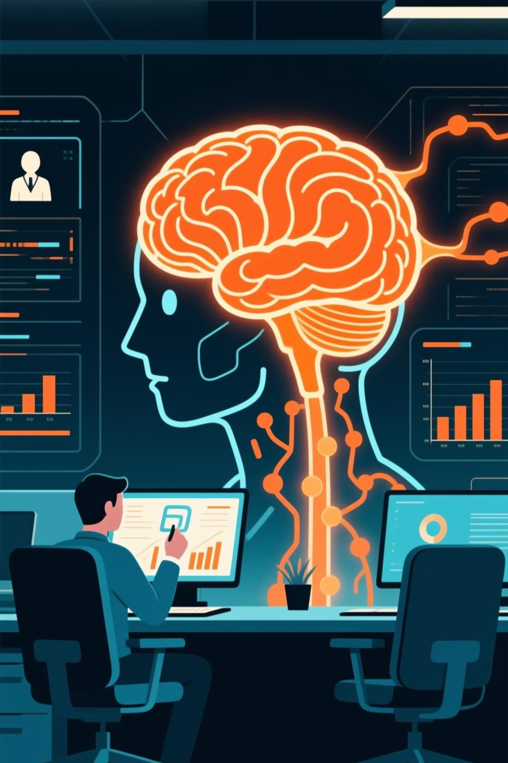
AI-Driven Employee Feedback Sentiment Analysis System
A cutting-edge Machine Learning & Natural Language Processing (NLP)-Based HR Analytics Solution designed to transform how organizations understand and respond to employee feedback.

Slide 2

Project Team
Driving Innovation in HR Analytics
Shaik Afsha Zareen Desai - AP23110011653
J.Deepthi - AP23110011670
CH.Ashwini- AP23110011647
Amrutha Preethi- AP23110010915
Bhanu Mitra - AP23110010978
Department: CSE, SRM AP

Slide 3

Problem & Objectives
The Challenge: Manual Feedback Limitations
Slow, inconsistent, and often biased manual review processes.
Difficulty analyzing vast volumes of unstructured employee comments.
Lack of immediate, actionable insights into workplace sentiment.
Our Solution: Automated Insights
Automate sentiment classification using advanced NLP and ML techniques.
Extract key themes and recurring issues for targeted intervention.
Deliver real-time dashboards to empower HR with data-driven decision-making.
Significantly improve accuracy, scalability, and speed of feedback analysis.

Slide 4





Proposed Solution: AI-Powered Workflow
Our system integrates cutting-edge AI for sentiment analysis with an intuitive web interface for visualization, providing a comprehensive HR analytics solution.
Feedback Input Layer
Employees submit feedback via various channels.
Text Cleaning & Preprocessing
Raw text is normalized for optimal analysis.
TF-IDF + Sentiment Engine
TF-IDF vectorization and Logistic Regression classify sentiment.
Keyword Extraction
Identifies prevalent topics and concerns.
Dashboard Visualization
Interactive dashboards present actionable insights.

Slide 5
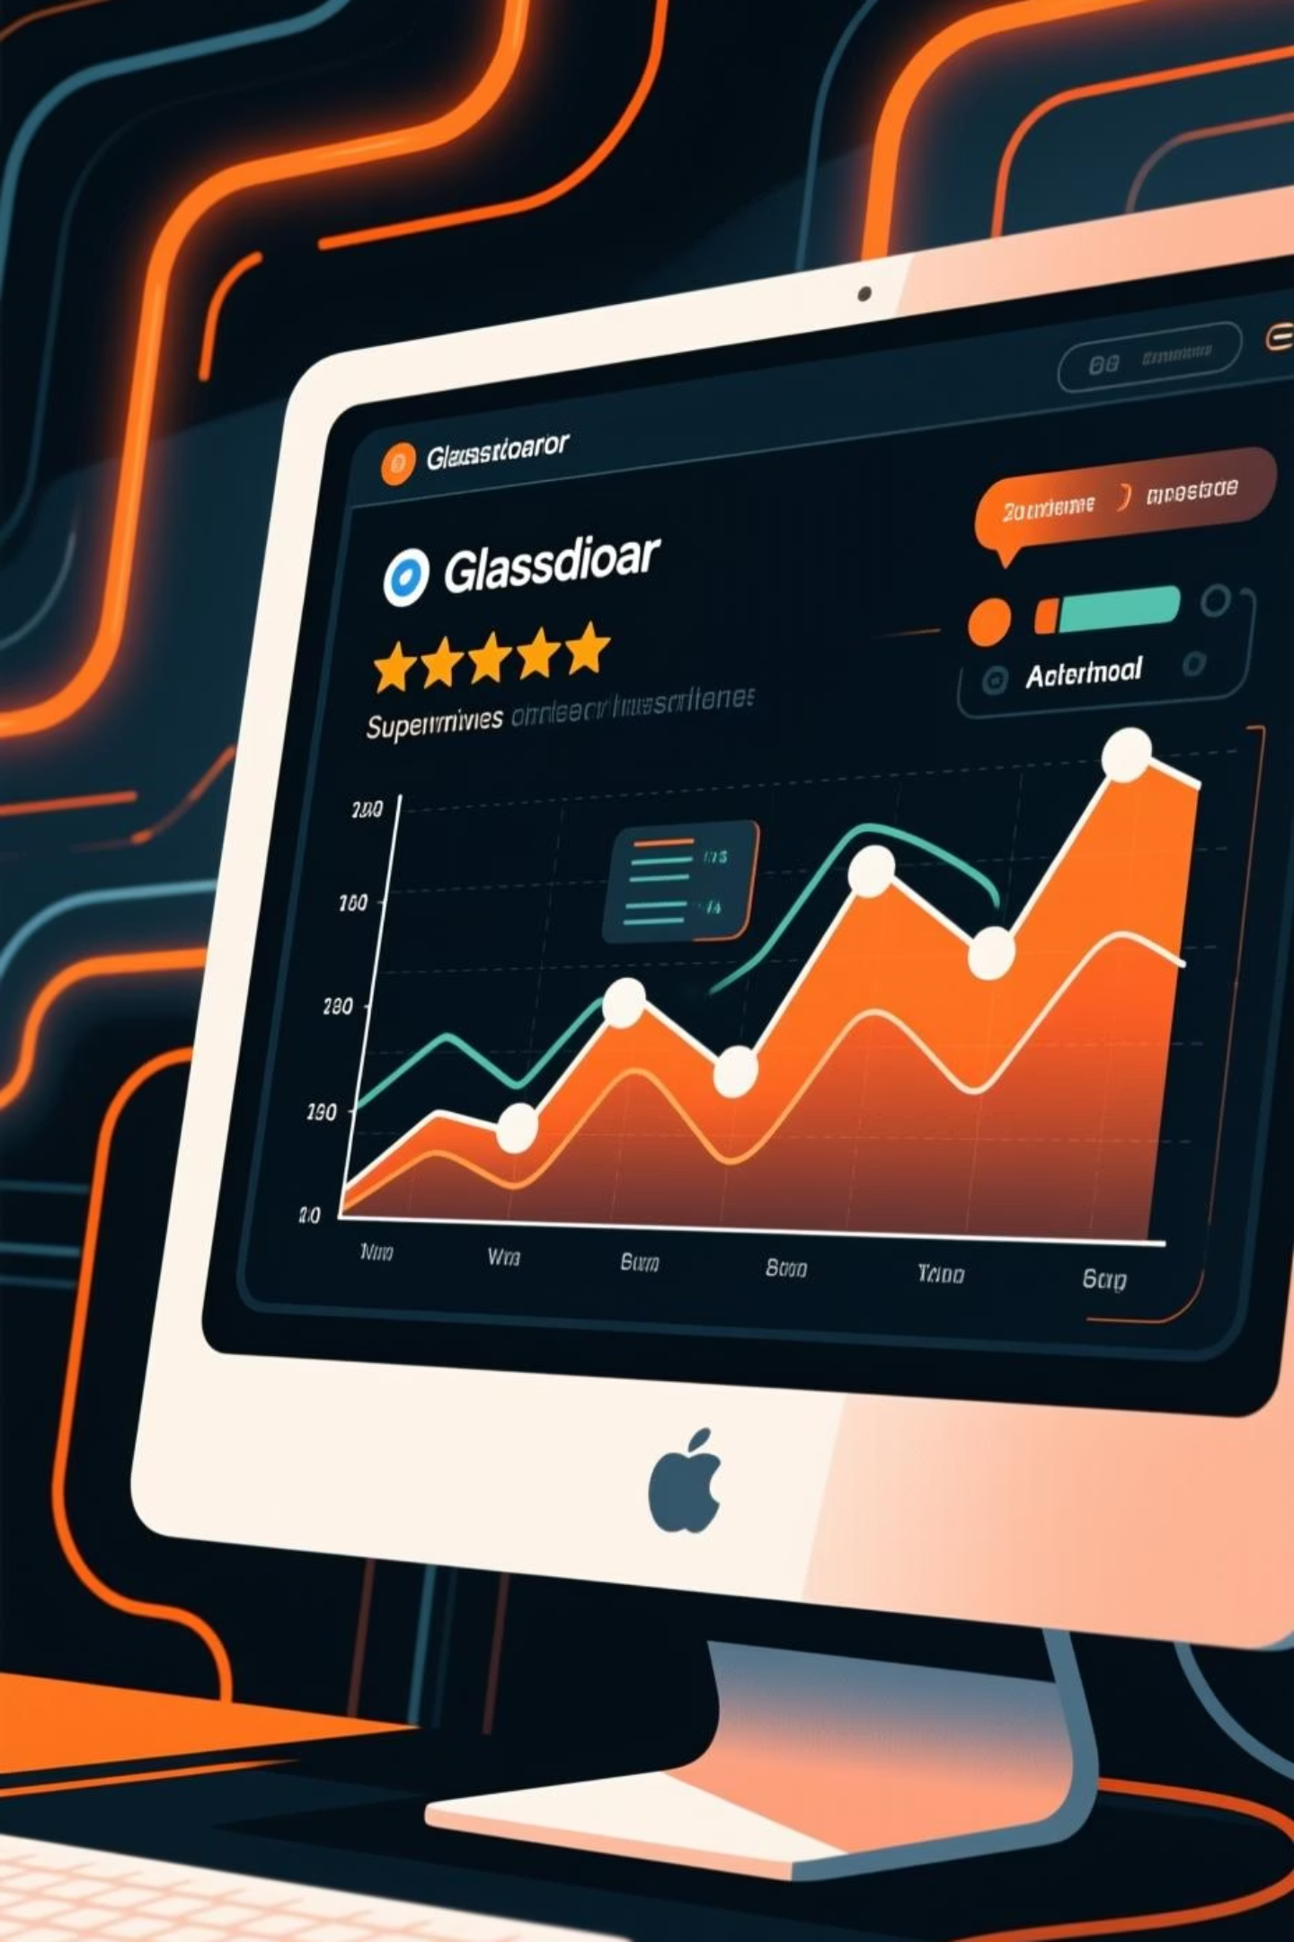
Dataset & Methodology
Dataset: Glassdoor Employee Reviews
Methodology: From Data to Insight
We utilized a publicly available Glassdoor dataset comprising employee reviews and associated numeric ratings.
Data Collection & Cleaning: Preprocessing raw text to ensure quality.
Includes comprehensive review text and corresponding rating scores.
TF-IDF Feature Extraction: Transforming text into numerical features for ML models.
Ratings were mapped to sentiment categories for supervised learning:
Logistic Regression: Training and testing our model for sentiment classification.
1–2: Negative Sentiment
3: Neutral Sentiment
Polarity Scoring: Assigning a sentiment score from -1 (negative) to +1 (positive).
4–5: Positive Sentiment
Keyword Extraction: Using CountVectorizer to identify crucial terms.

Slide 6




Technologies Utilized
Programming & Tools
Python Libraries
Python 3.x, Flask, HTML, CSS, Chart.js, VS Code
Pandas, NumPy, Scikit-Learn, Regex, Pickle
Core Concepts
NLP preprocessing, TF-IDF, Logistic Regression, Rule-based NLP, Flask routing & Jinja2

Slide 7

Results & Findings
Model Performance & Dashboard Views
Key Discoveries & HR Impact
Accurate sentiment classification across positive, neutral, and negative categories.
Revealed significant, often hidden, HR issues such as workplace toxicity, excessive workload, and leadership concerns.
Interactive dashboards feature sentiment summary cards, bar charts, and satisfaction graphs.
Demonstrated the ability to detect shifts in employee sentiment following policy changes or corporate events.
Dynamic keyword clouds highlight critical themes like "work," "quality," and "manager."
Proved invaluable for enhancing the effectiveness of annual employee surveys and exit interviews.
Detailed sentiment tables provide granular polarity scores for deeper analysis.

Slide 8

Thank You !

